Slide 1
Programming training (1)
Chun-Yuan Lin

Slide 2
Line
void lineSegment (void)
{
glClear (GL_COLOR_BUFFER_BIT); // Clear display window.
glColor3f (1.0, 0.0, 0.0); // Set line segment color to red.
glBegin (GL_LINES);
glVertex2i (180, 15); // Specify line-segment geometry.
glVertex2i (10, 145);
glEnd ( );
glFlush ( ); // Process all OpenGL routines as quickly as possible.
}

Slide 3
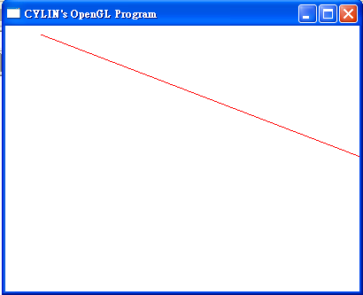

Slide 4
POLYGON
void DrawPOLYGON (void)
{
glClear (GL_COLOR_BUFFER_BIT);.
glColor3f (0.0, 1.0, 0.0);
glBegin(GL_POLYGON);
glVertex2i (0,0);
glVertex2i (0,100);
glVertex2i (100,0);
glEnd ( );
glFlush ( );
}

Slide 5
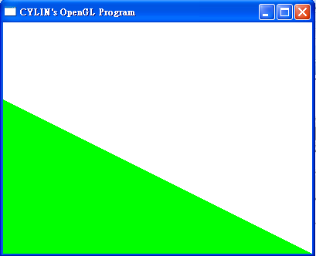

Slide 6
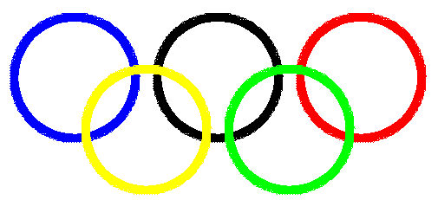
Problems
Please draw the Figures:

Slide 7
Training 1
Please send the Source code (*.c or *.cpp) and Executable file to me (cyulin@mail.cgu.edu.tw) before 10/7, 23:59:59.
Please annotate your name and your student ID in email.
  The file name is “student ID”. If more than one files, the names are “student ID-1”, “student ID-2”, etc.
  Please compress the file(s) to a .zip or .rar file. The file name is “student ID-train1”.
  For example, a student has ID “A0000001” and two source code files. The source code file names are A0000001-1.c and A0000001-2.c and the compressed file name is A0000001-train1.zip.
The files will be rejected without following the rules.

